Slide 1

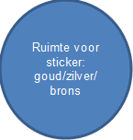

Diploma
200m wisselslag
^{Uitgereikt aan}
.....................................................................................................................................................................
Datum ........................................................................................................... .......... ..........
^{Tijd} ...............................................................................................200m wissel
.
............................................................................................... ...50m benen
Zilver 200m wissel < 4.15 + 50m benen <1.10
Goud 200m wissel < 4.03 + 50m benen <1.00

